Slide 1
Lecture 4; Drive System

Slide 2
What to be learned
Define propeller shaft and Half shaft
Distinguish between propeller shaft and Axle shaft(Half Shaft)
Describe propeller shaft and drive Axle shaft
Perform maintenance on propeller shaft and drive Axle shaft

Slide 3
Introduction
A shaft is a rotating machine element which is used to transmit power from one place to another
In order to transfer the power from one shaft to another, the various members such as pulleys, gears etc., are mounted on it

Slide 4
Introduction
The shafts are usually cylindrical, but may be square in section.
They are solid in cross-section but sometimes hollow shafts are also used.
Also, must be absolutely straight and in balance so that it does not generate vibration at operating speed.

Slide 5
Introduction
Types of Shafts
There are two types of shafts which are
Transmission shafts
Machine shafts

Slide 6
Introduction
Types of Shafts
Transmission shafts
These shafts transmit power between the source and the machines absorbing power.
The counter shafts, propeller shaft, half shaft and all factory shaft are transmission shafts.

Slide 7
Introduction
Types of Shafts
b. Machine shafts
These shafts form an integral part of the machine itself.
The crank shaft is an example of machine shaft.

Slide 8
Propeller Shaft
Propeller shaft is the hollow cylindrical shaft that transmit turning power from the gearbox output to the differential which then to final drive and driving axle.
It is sometimes called prop shaft or drive shaft

Slide 9
Propeller Shaft Construction
One-piece propeller shaft
The construction of one-piece prop shaft consists;-
Shaft
The main body of the propeller shaft comprises a steel tube into the ends of which are welded steel stub portions forming part of the end joints.

Slide 10
Propeller Shaft Construction cont..
One-piece propeller shafts
Fixed joint
Each end of the propeller shaft is provided with a hinged joint of the universal type.
The hinged joints allow the shaft to adjust its position to the changing angle of the drive line at all times as it rotates.

Slide 11
Propeller Shaft Construction cont..
One-piece propeller shafts
Sliding joint
Some form of sliding or telescopic joint is required in the propeller shaft assembly, so that it can accommodate itself to small variations in effective length of the drive line.
A splined coupling is therefore typically incorporated between the front universal joint and either the main body of the propeller shaft or the tail shaft of the gearbox.

Slide 12
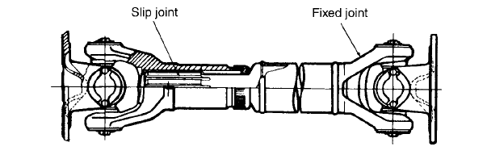

Slide 13
Propeller Shaft Construction cont..
Two-piece propeller shafts
A two-piece or divided propeller shaft is often employed in the drive lines of front-engine RWD vehicles
This type of assembly comprises the following basic components:

Slide 14
Propeller Shaft Construction cont..
Primary shaft
This forms the front section of the propeller shaft, its forward end connecting to the universal joint behind the gearbox.
At its other end, the primary shaft is shouldered to accept a support bearing.

Slide 15
Propeller Shaft Construction cont..
Centre bearing
Through being located on the rear end of the primary shaft, this bearing serves as an intermediate support for the propeller shaft assembly.

Slide 16
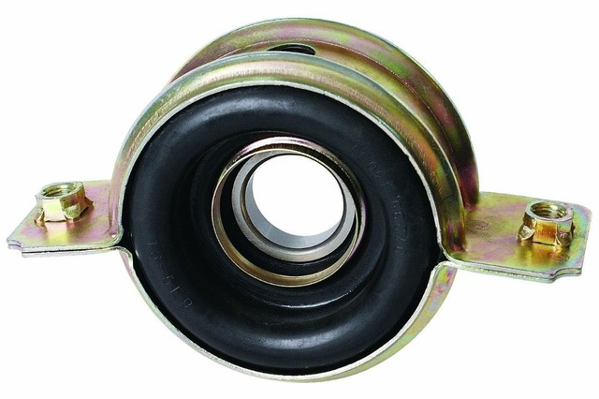

Slide 17
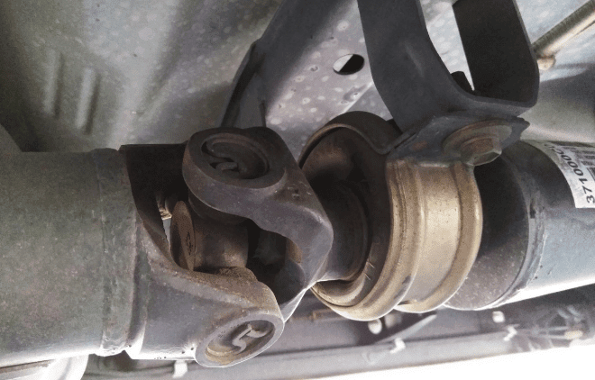
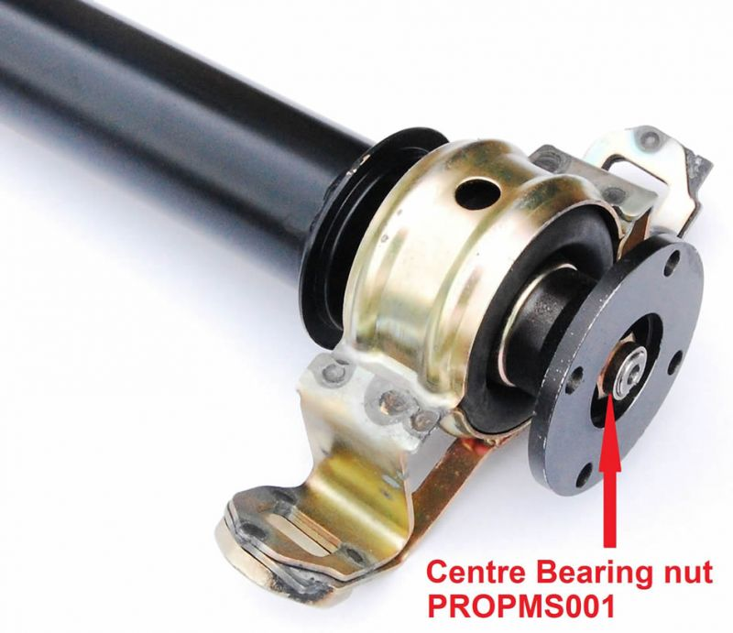

Slide 18
Propeller Shaft Construction cont..
Secondary shaft
This forms the rear section of the propeller shaft and connects to the final drive.
It is provided with two universal joints, one at each end.
A sliding joint is provided between the main body of the secondary shaft and either the front or, less commonly, the rear universal joint.

Slide 19
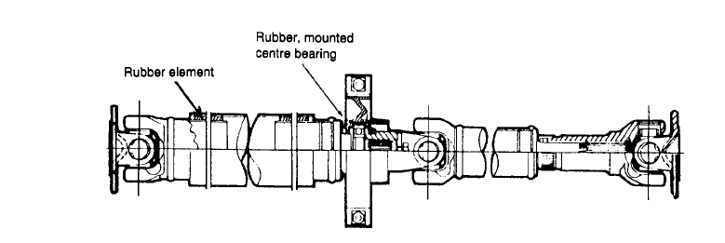
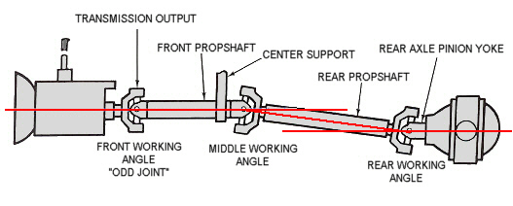

Slide 20
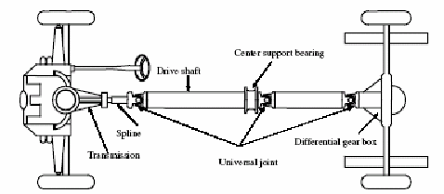

Slide 21
Propeller Shaft Construction cont..
A three-pieces propeller shaft
There some times three pieces of shaft are used but it has the same part as two propeller shaft except this has two centre bearing and three pieces of shafts

Slide 22
Propeller Shaft Construction cont..
Inter-axle or coupling shaft
It is required to transmit the drive from one differential to the other

Slide 23
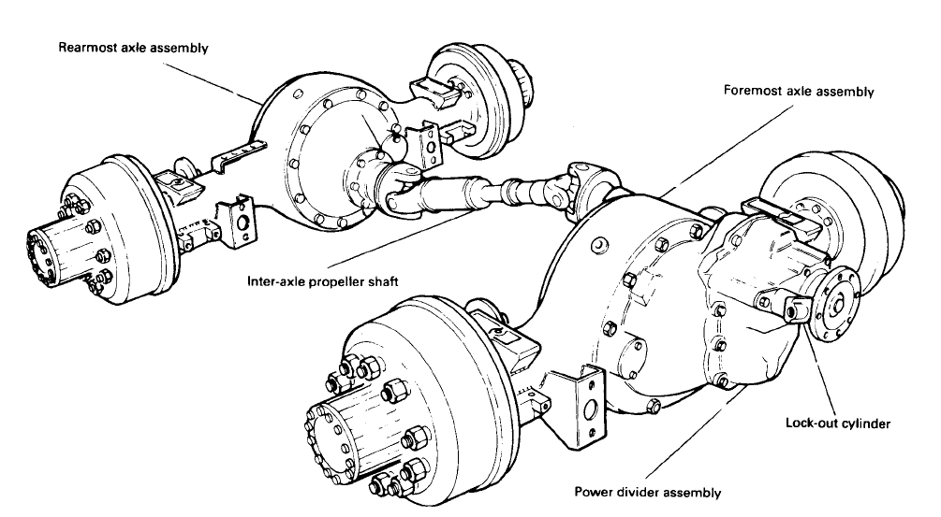

Slide 24
Universal Joint
U-Joint (sometimes called a Cardan or Hooke’s joint) is a pivoting coupling made up of a four-way center crosspiece mounted between two yokes.
This crosspiece (sometimes called a spider) is the heart of the U-Joint.

Slide 25
Universal Joint
There is a precision-machined journal called a trunnion at each of the crosspiece's four ends.
A bearing cup assembly fits over each trunnion and contains a row of needle bearings that roll on the trunnion surface.

Slide 26
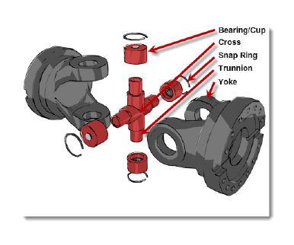

Slide 27
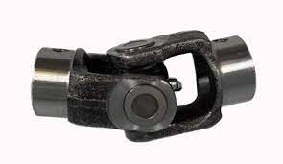

Slide 28
Universal Joint
Why can't propeller shafts be solid or of a fixed length?
When the vehicle is driven, the rear axle assembly moves up and down on the vehicle's suspension.
This movement requires the drive shaft to have the ability to flex and change length as the axle moves

Slide 29
Universal Joint
Slip yoke is designed to accommodate this required change in driveshaft length by sliding in and out of the transmission tailshaft housing.
The slip yoke and transmission tail-shaft are coupled using splines which allow the slip yoke to slide while receiving power from the tail-shaft.
The slip yoke in most instances is coupled to the driveshaft via a universal joint.

Slide 30
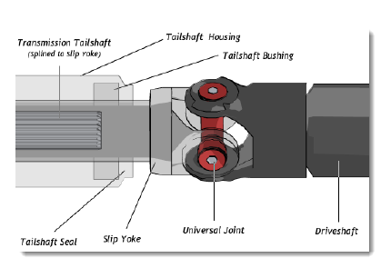

Slide 31
Drive Axle Shaft(Half shaft)
Drive Axle shaft (Halfshaft) is shafts that transmit turning power directly between the transaxle and the road wheels.
It used for front engine and it can be;-
a. Equal length drive Axle shafts
b. Unequal length drive axle shafts

Slide 32
Drive Axle Shaft(Half shaft) cont..
Equal length drive Axle shafts
In all front-wheel-drive cars with fore-and-aft mounted engines and transaxles, the drive Axle shafts can obviously be made equal in length.

Slide 33
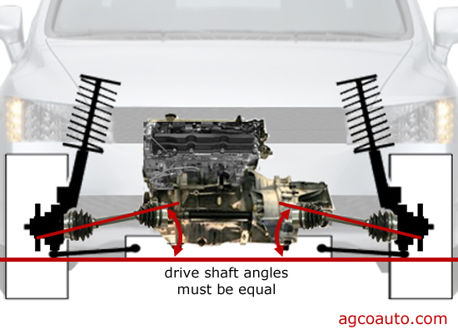

Slide 34
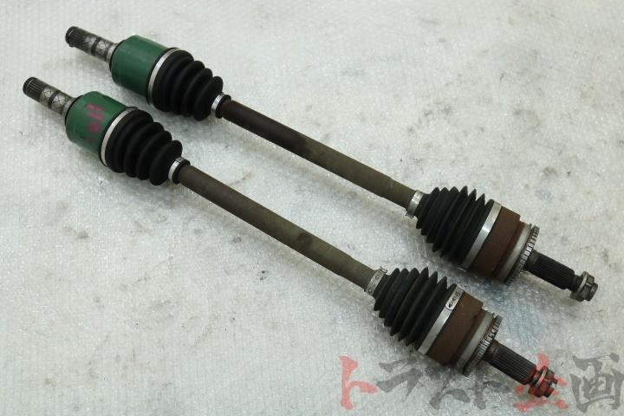

Slide 35
Drive Axle Shaft(Half shaft) cont..
b. Unequal length drive axle shafts
For front-wheel-drive cars with transversely mounted engines and transmissions, the final drive housing can be offset appreciably from the mid-track of the wheels, such that the difference in lengths between the long and short drive shafts can be typically in the ratio of 3:2.

Slide 36
Drive Axle Shaft(Half shaft) cont..
If the long and short shafts are made the same diameter then power is supplied to one wheel momentarily before the other.
To minimize this effect the longer shaft is stiffened by making it of larger-diameter tubular construction, while the shorter shaft remains of smaller-diameter solid construction

Slide 37
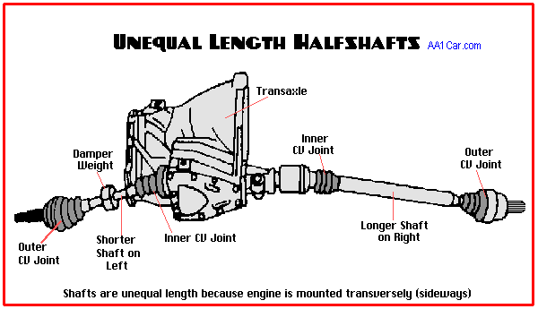

Slide 38
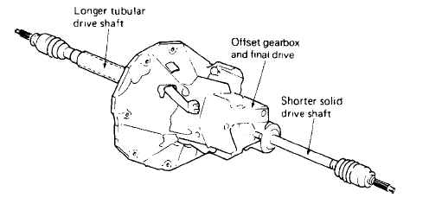

Slide 39
Constant Velocity (CV) Joint
Constant Velocity (CV) Joints are designed to allow the halfshaft to transmit power and motion through a variable angle at constant rotational speed.
CV joints has got different designs which are
Rzeppa-Style Joint Design
Tripod-Style Joint Design

Slide 40
Constant Velocity (CV) Joint cont.
a. Rzeppa-Style Joint Design
The Rzeppa joint consists of a spherical inner and outer races connected by six steel bearings that run in longitudinal grooves cut into both races.
They are most common used as outer CV joint
Note: Rzeppa is pronounced "shep-ah"

Slide 41
Constant Velocity (CV) Joint cont.
a. Rzeppa-Style Joint Design cont..
The axle shaft is splined to the inner race, which is retained by an external or internal snap ring.
The outer race has a stub shaft made onto its outside end which is splined to the wheel hub.
A cage fitted between the inner and outer race retains the bearings.
The bearings connect and transmit power and motion between the inner and outer races.

Slide 42
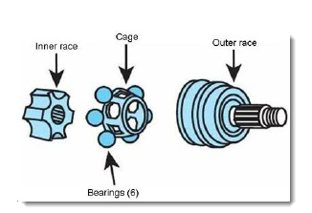

Slide 43
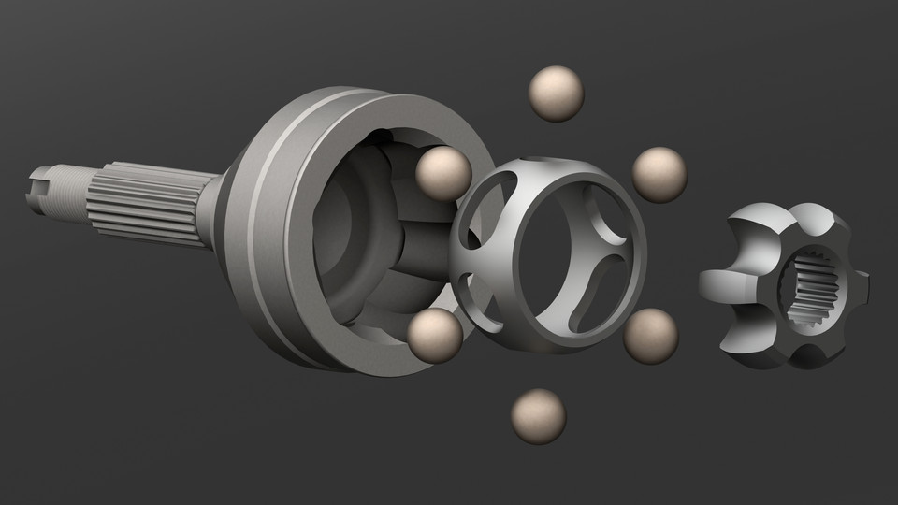

Slide 44
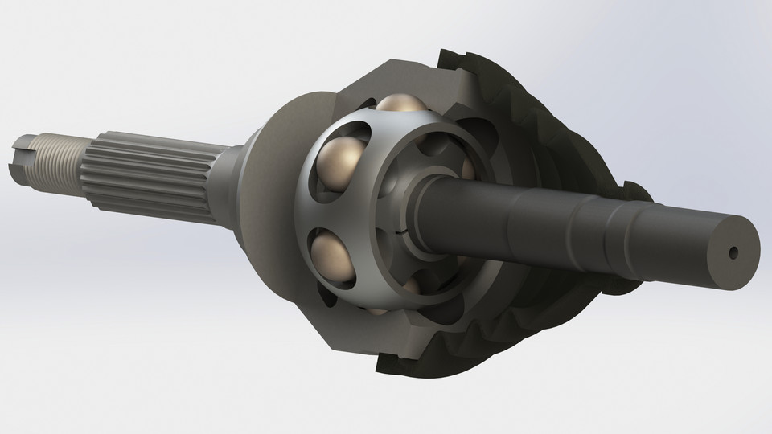

Slide 45
Constant Velocity (CV) Joint cont.
b. Tripod-Style Joint Design
The tripod joint consists of a three-legged inner race or cross with rollers on the end of each leg.
This inner race is splined to the axle shaft, and is retained by an external or internal snap ring.
They are most common used as inner CV joint
The rollers connect and transmit power and motion between the inner and outer races

Slide 46
Constant Velocity (CV) Joint cont
b. Tripod-Style Joint Design
This type of joint is designed to plunge in and out with suspension movement and corresponding half-shaft length change.
The axle shaft is splined to the inner race, which is retained by an external or internal snap ring.
The outer race or tulip have a stub shaft made onto its outside end for attachment to the output shaft of the transaxle.

Slide 47
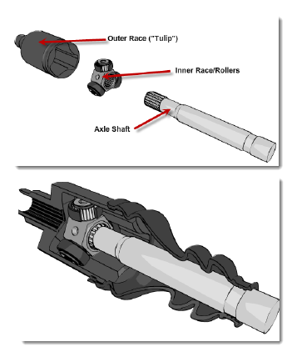
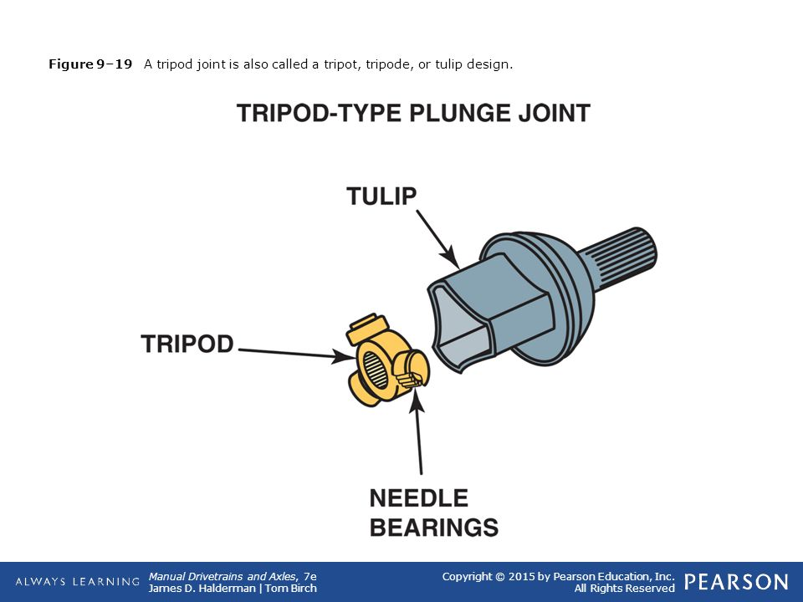

Slide 48
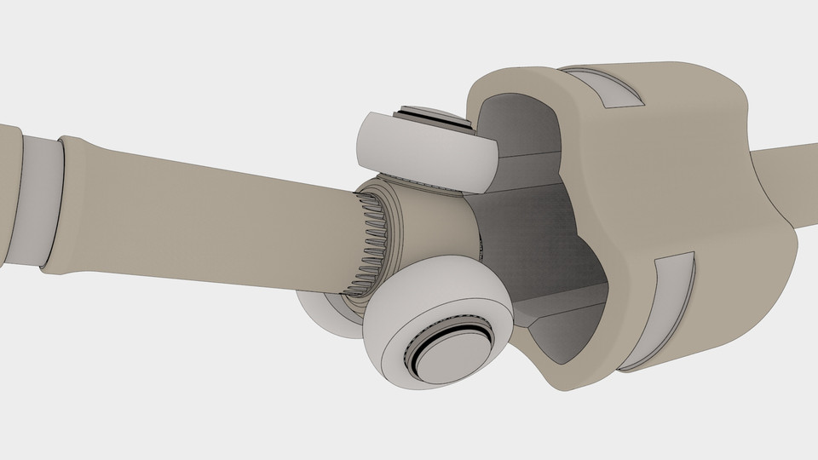

Slide 49
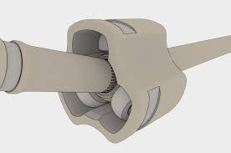

Slide 50
Constant Velocity (CV) Joint cont
Boots and Clamps
All CV Joints are enclosed by a neoprene or plastic boot to keep lubricant in and contaminants out.
The boot is convoluted to allow it to flex as halfshaft angles change.

Slide 52
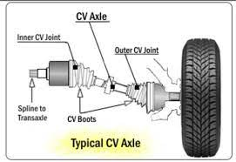

Slide 53
Differences of half shaft from propeller shaft
The location of the half shafts is such that they are necessarily shorter in length.
Since the half shafts operate directly between the final drive and the road wheels they transmit greater torque.
They are always in pair

Slide 54
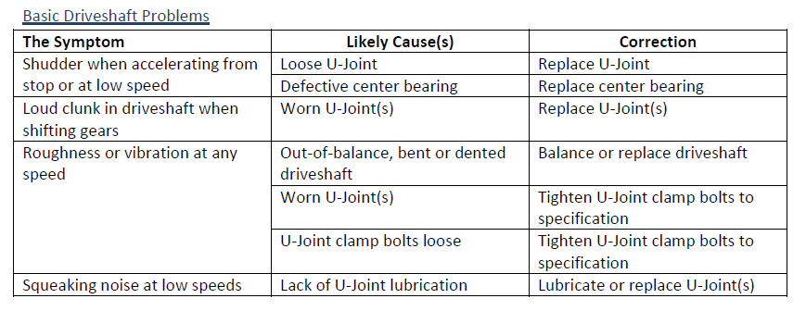
Maintenance of Propeller shaft

Slide 55
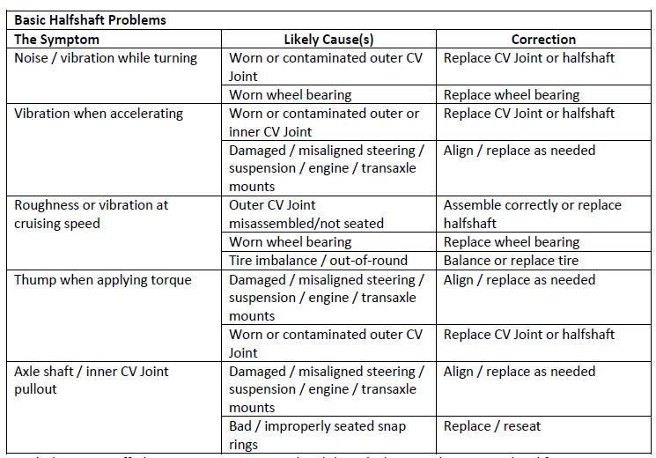
Maintenance of Half shaft

Slide 56
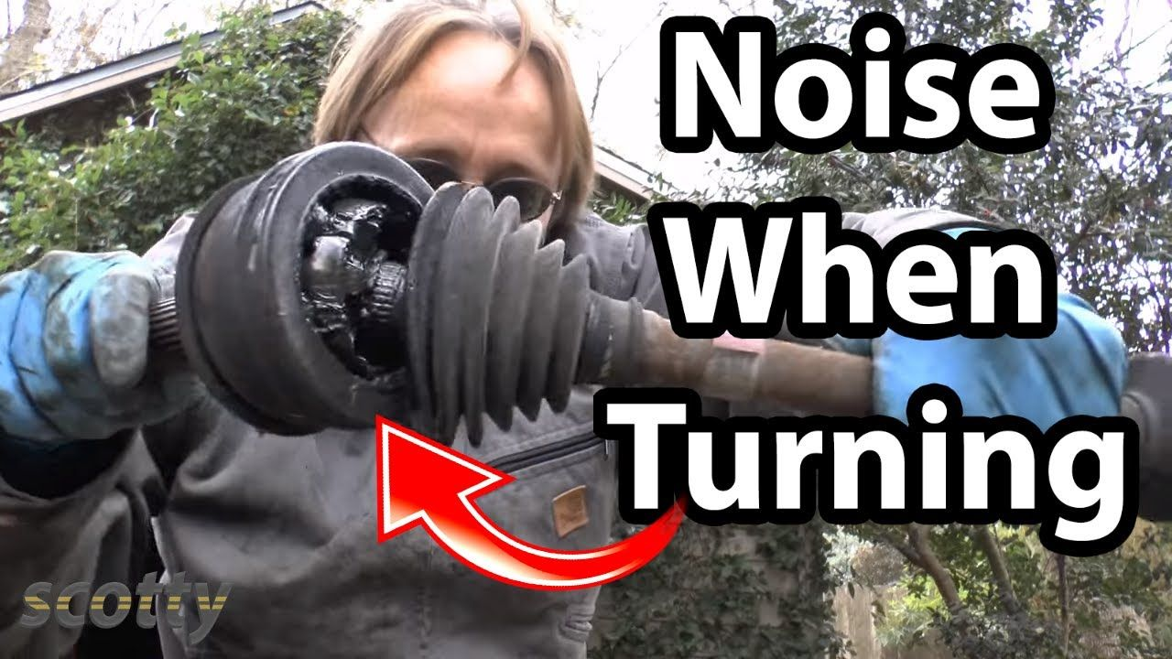

Slide 57
Thanks

